Slide 1
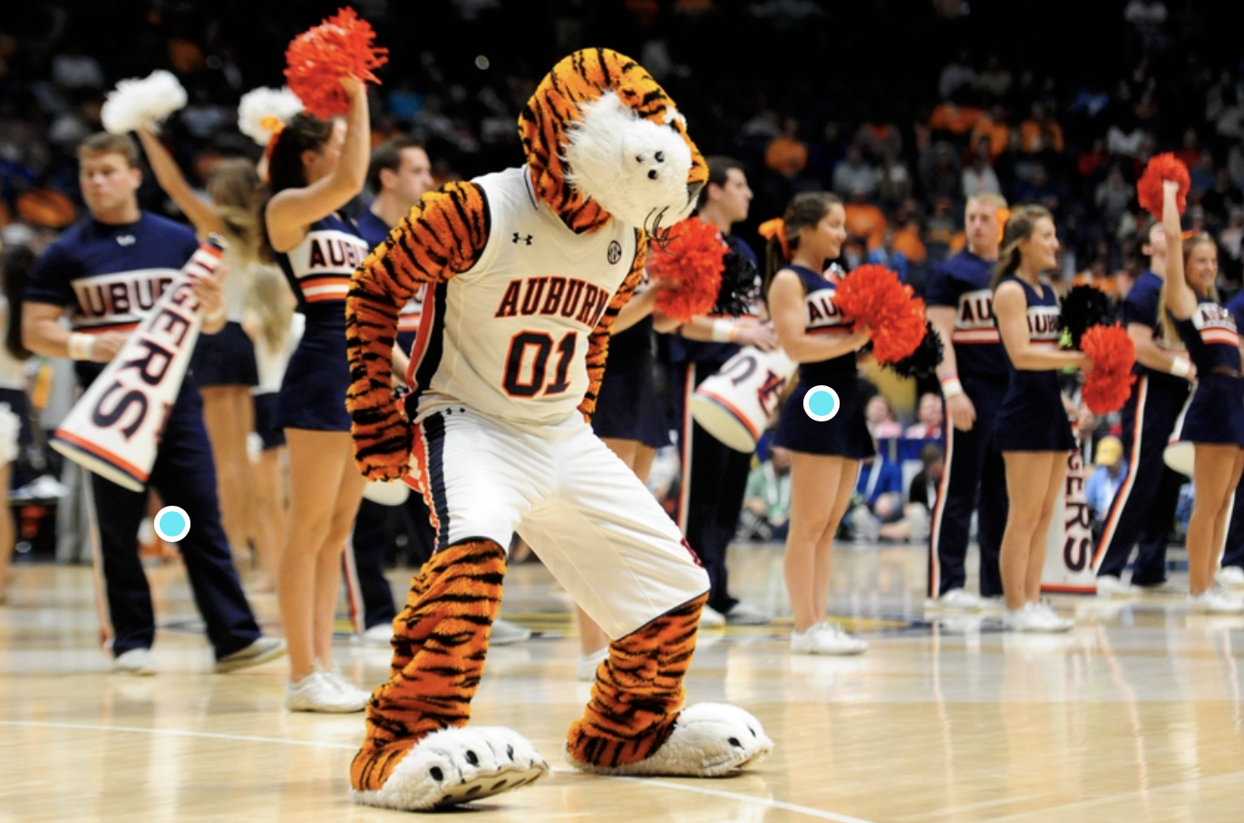

War Damn Eagle
Siyu Yuan
Yida Bao
Rachel Wang
Masuzyo Mwanza

Slide 2
Contents
Introduction
Objective
Data visualization
Shoot Stats
Shot percentages over time
Regular Season Stats
Summary

Slide 3

Background
We know that “March Madness” is the most important stage for college basketball NCAA. Today, we will talk about expectations for Auburn Tiger’s performance this year.

Slide 4
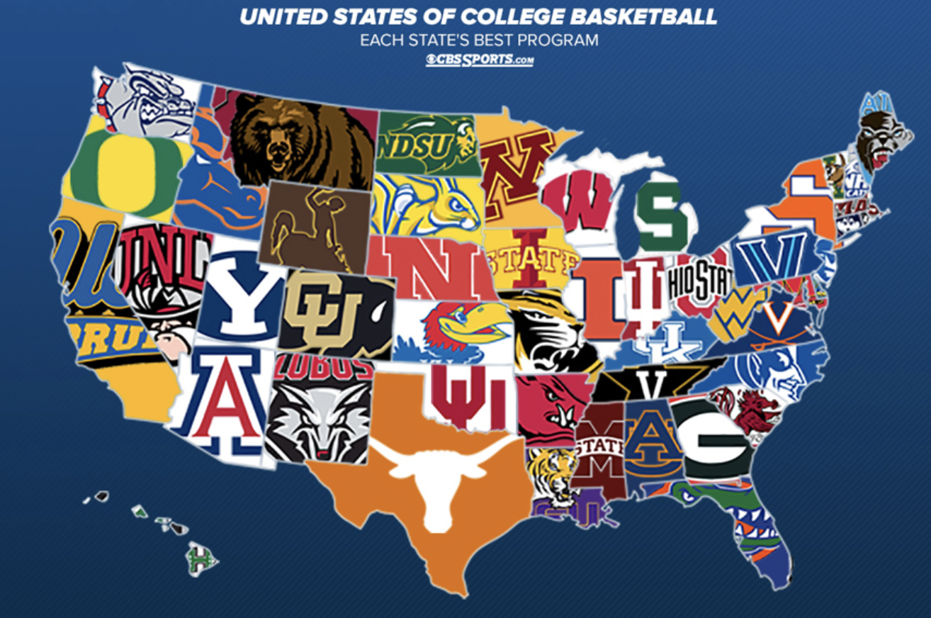

Slide 5
Objective
We naturally have expectations for Auburn Tiger’s performance this year. In this project, we will use methods of data visualization instead of icy statistics output to compare the game data of Auburn and those top teams. And explore the reason why we can expect something from auburn tiger this season.

Slide 6
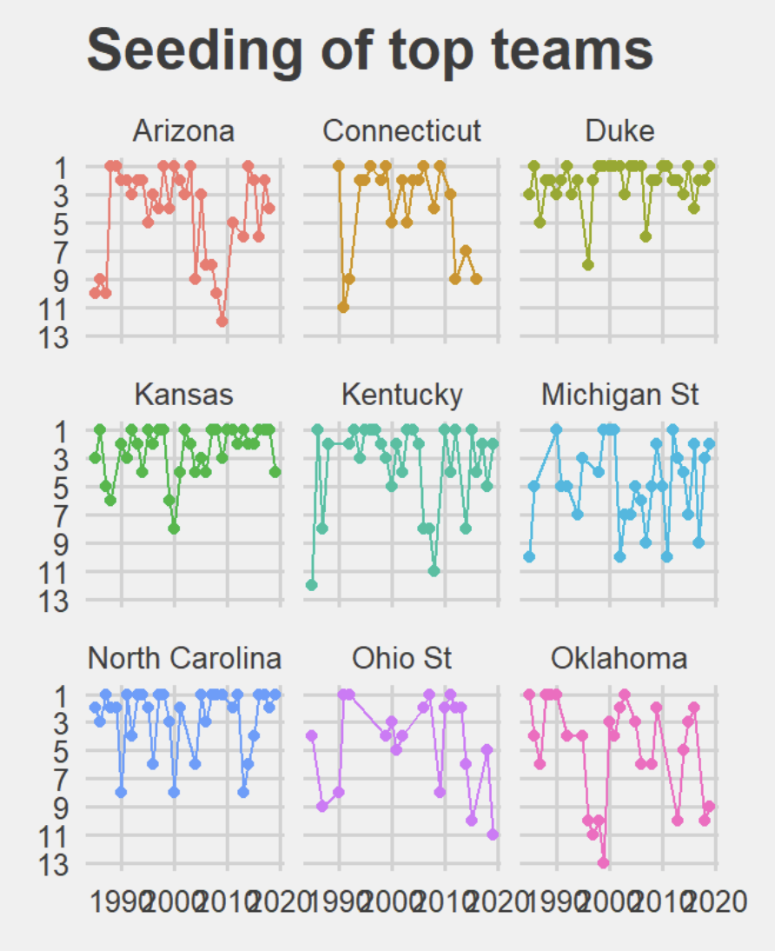
Introduction
Auburn has been participated in
the NCAA competition from 1985 to 2020
The basic idea of this project is to compare the stat of auburn’s game with those of the traditional top teams
Arizona, Connecticut, Duke, Kansas, Kentuck, Michigan St, North Carolina, Ohio st and Okalahoma as top team. They are well-known among basketball fans and have a large number of fans.

Slide 7
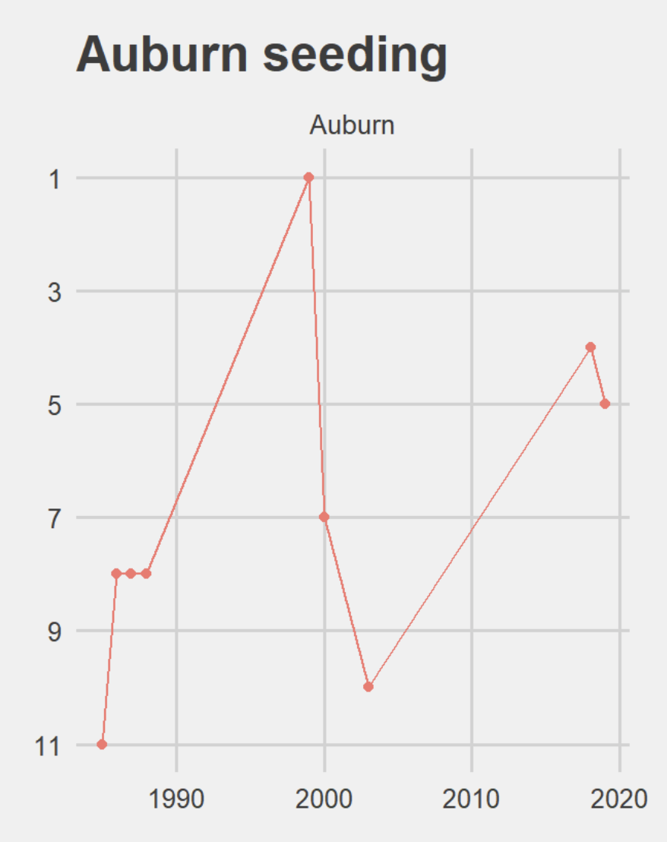
Auburn seeding
From the graph, we can find that Auburn only got one time first seed in 30 year. Even if we relax the criteria, there are only a handful times of Auburn entries in the top five.

Slide 8
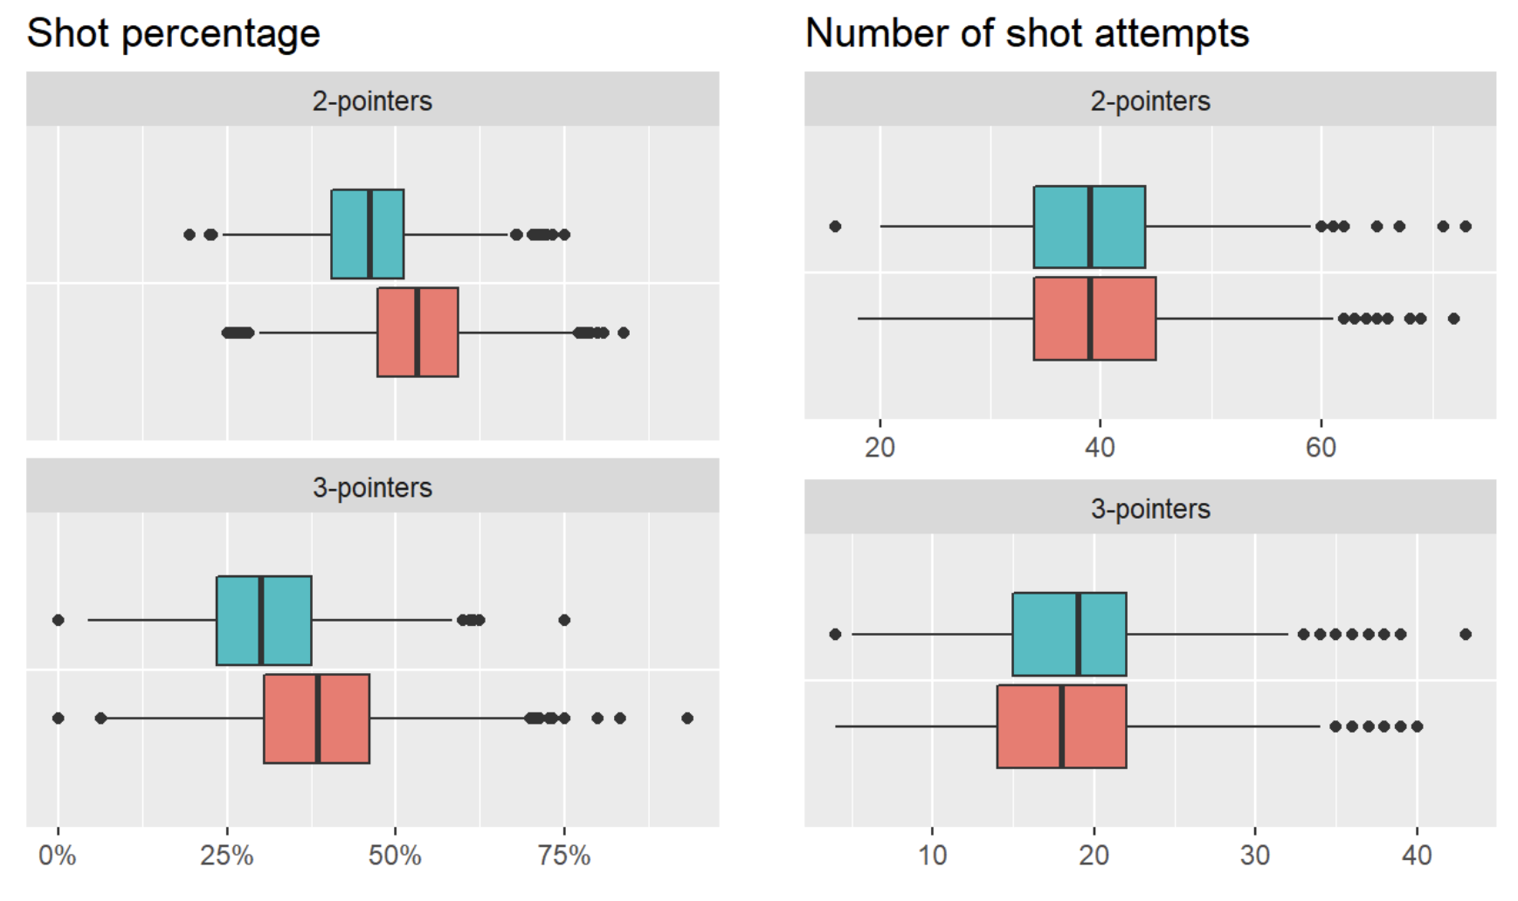
Shoot Stats: Top Team Top team (red) VS opponent (blue)

Slide 9
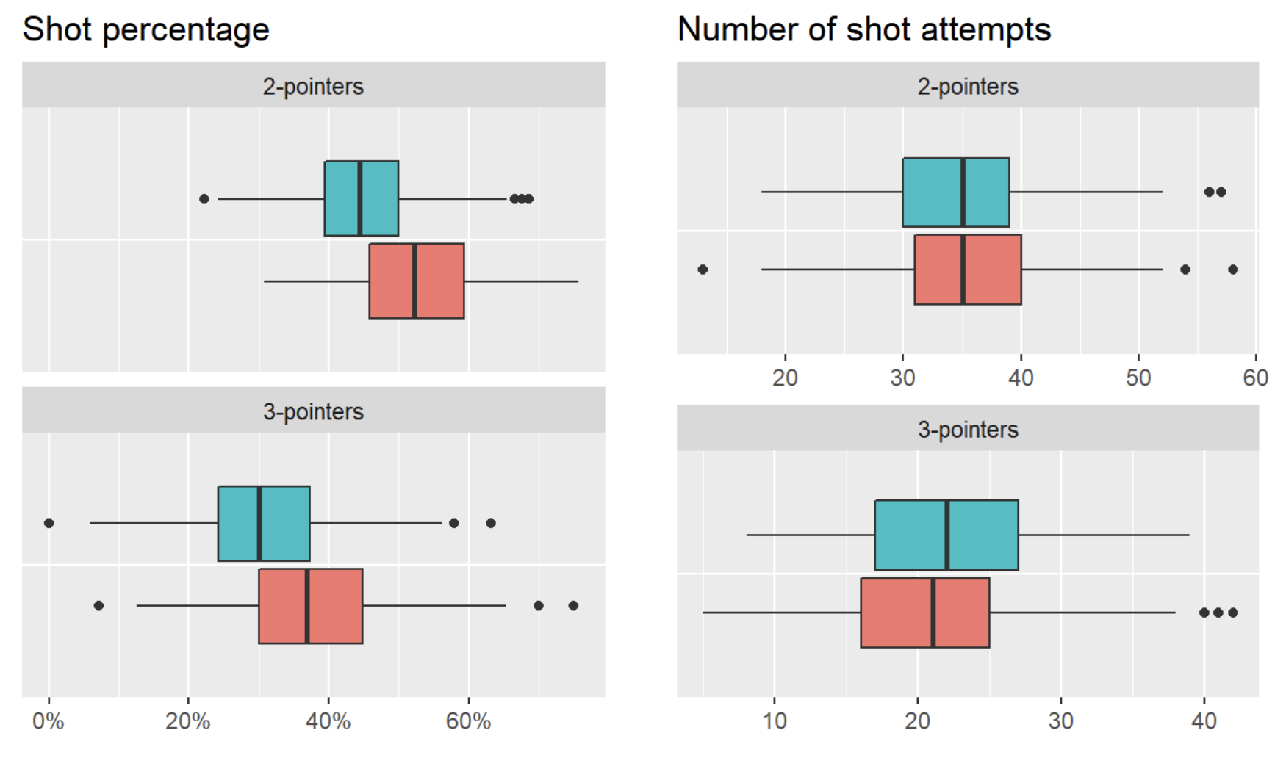
Shoot Stats: Auburn Auburn (red) vs opponent (blue)

Slide 10
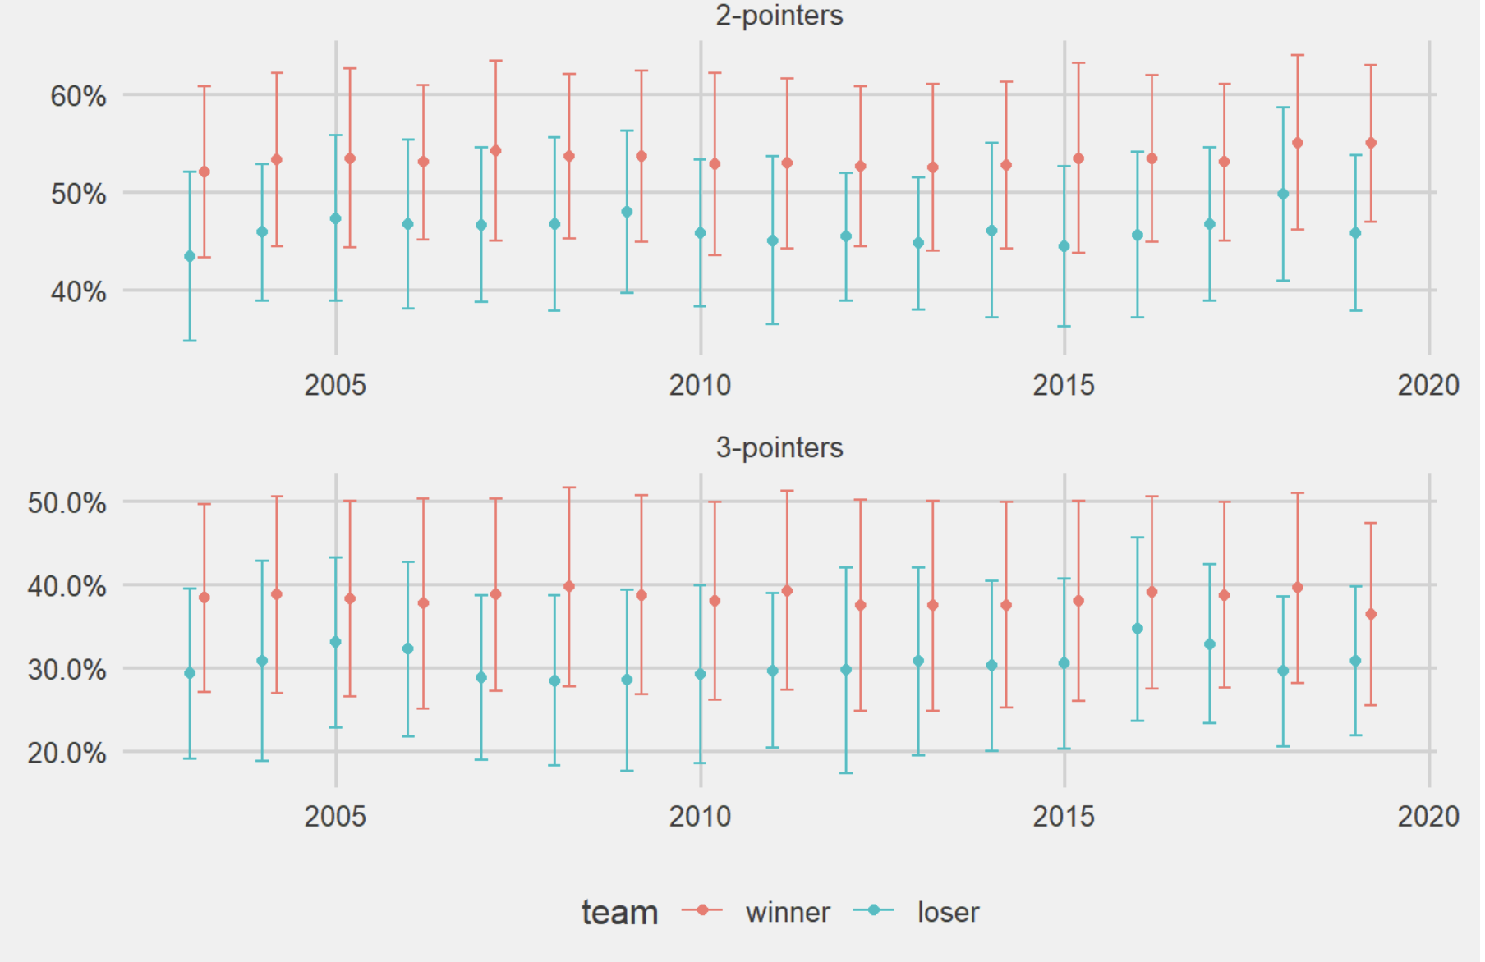
Shot percentages over time – Top teams Mean percentage with standard deviation error bars

Slide 11
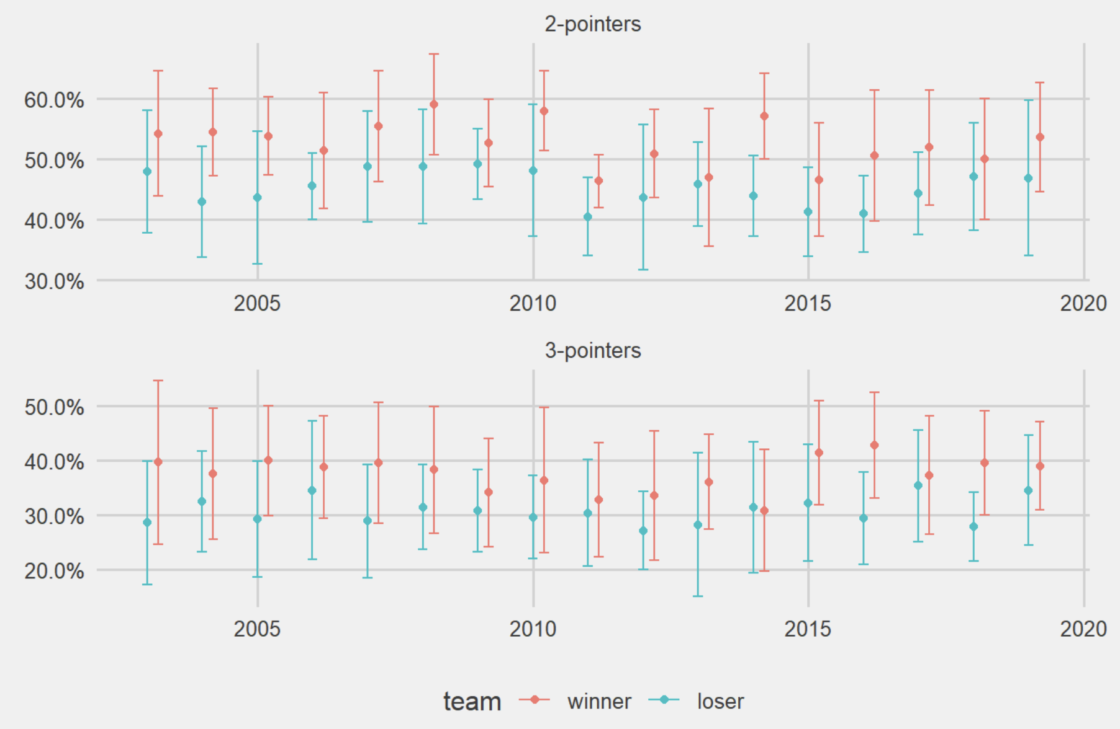
Shot percentages over time – Auburn Mean percentage with standard deviation error bars

Slide 12
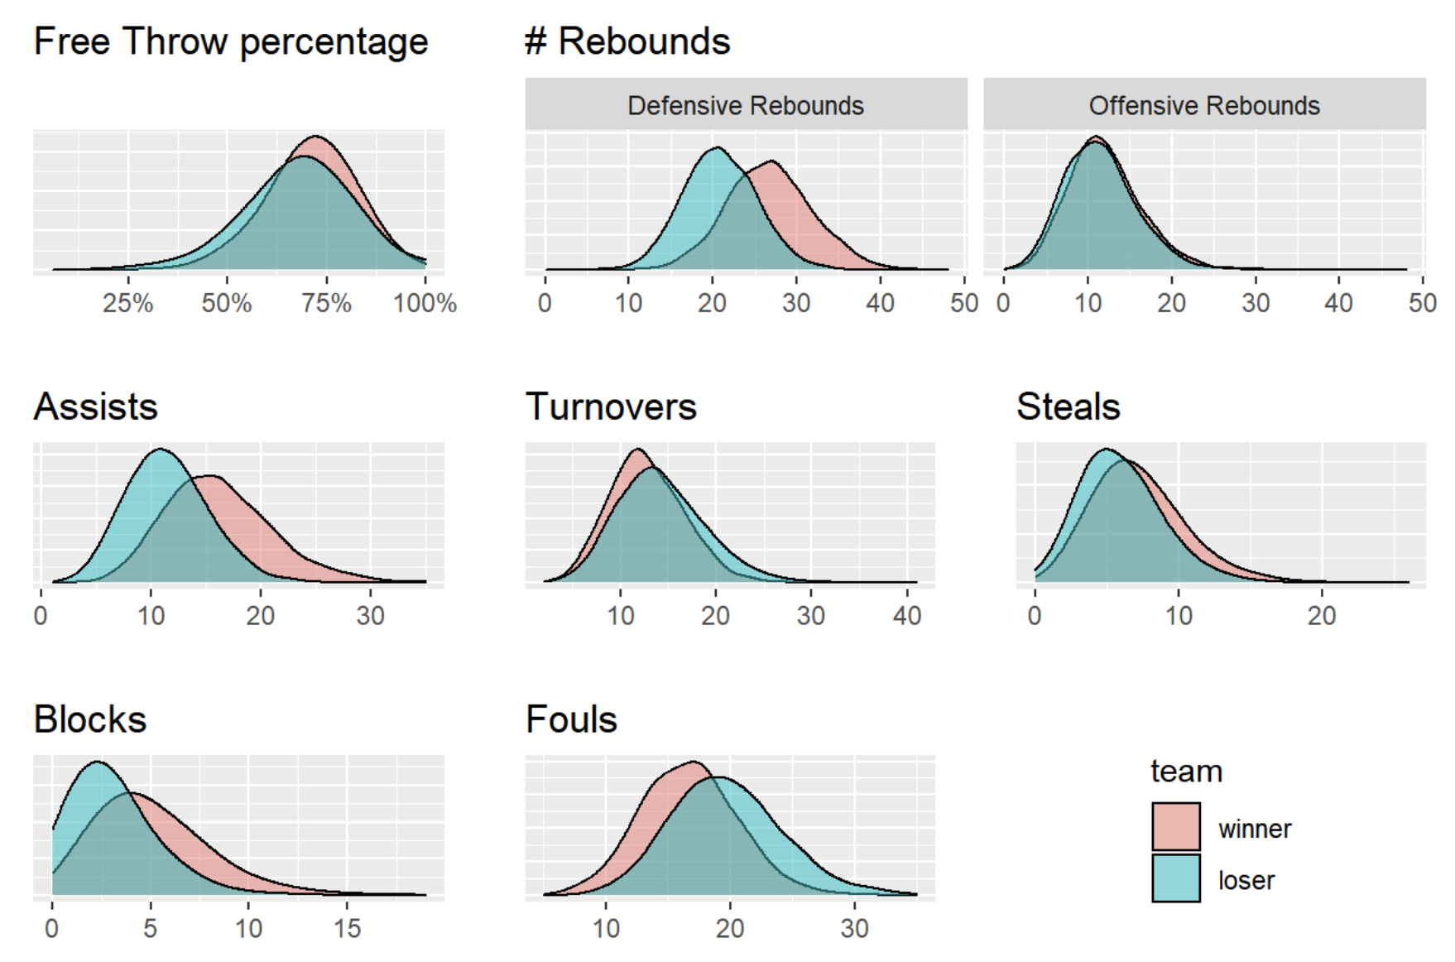
Regular Season Stats Top teams

Slide 13
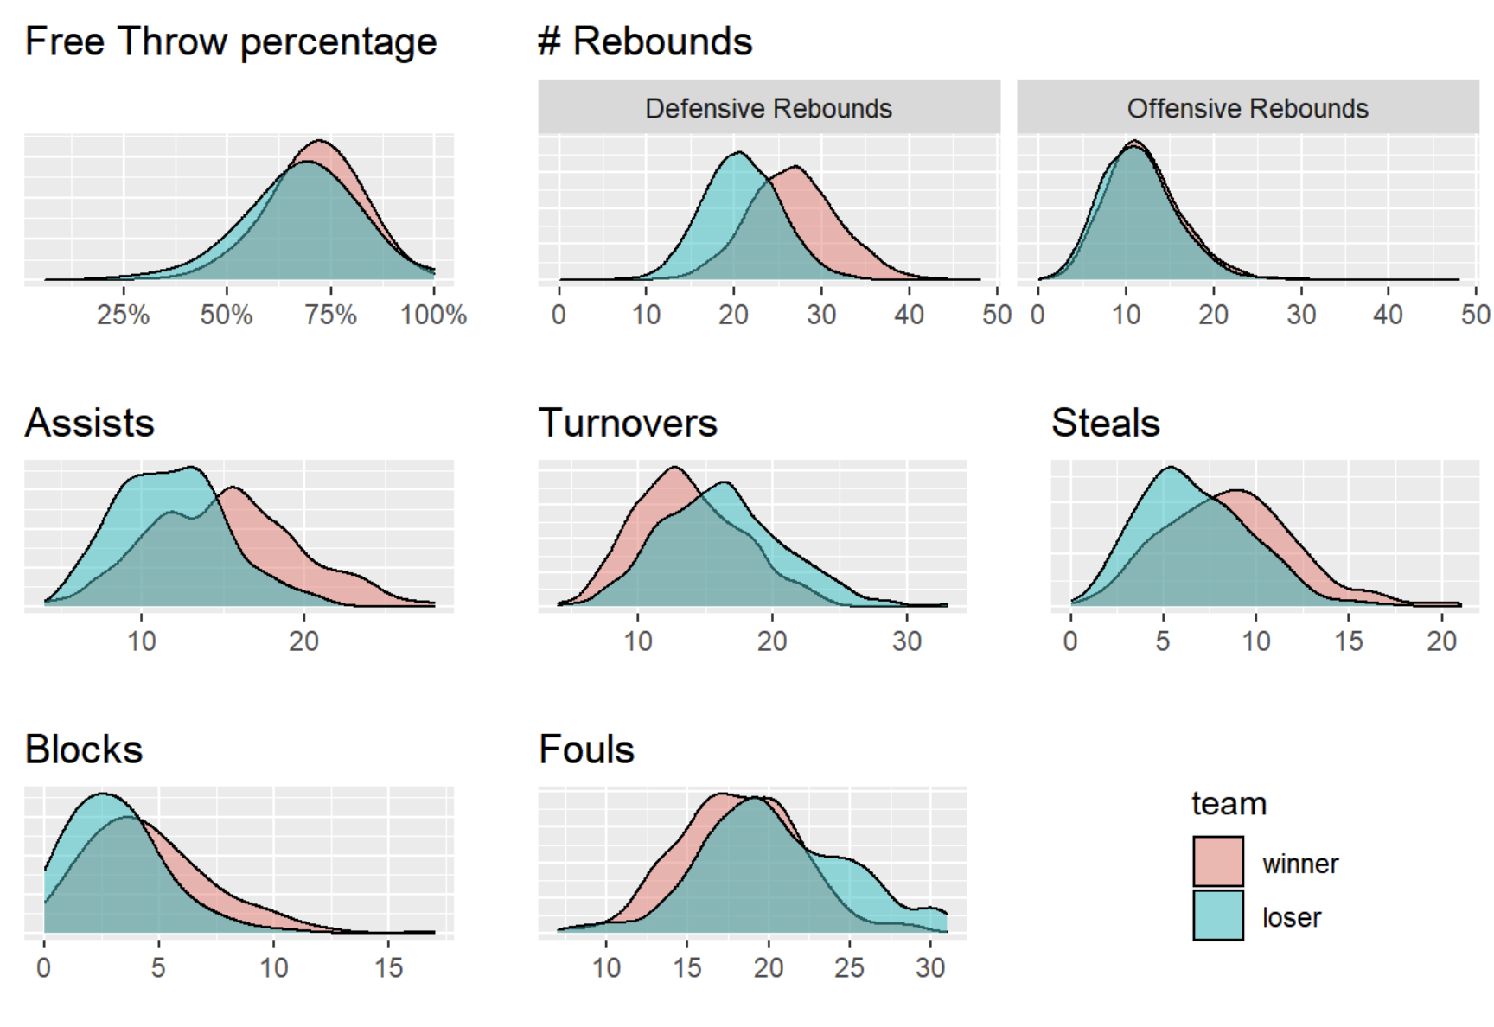
Regular Season Stats Auburn

Slide 14
Summary
This is a data visualization project. We compared the game data of the top team and their opponents, and then we did the same for auburn. From the results in the figure, we can say that auburn already possesses some of the characteristics of the top teams.

